Slide 1


ANALYSIS REPORT
Unveiling Insights from Over a Century of Film Data (1914-2019)
Prepared by: Kunal Malviya

Slide 2
CONTENT
Introduction
Problems & Background
Recommended Analysis
Conclusion

Slide 3

Introduction
Comprehensive analysis of over 15,000+ films reviewed on Rotten Tomatoes.
Focus on critical and audience reception from 1914 to 2019.

Slide 4


Problem & Background
Identify key factors influencing film success.
Analyze historical trends in movie ratings and audience preferences.
Provide actionable insights for industry stakeholders.
Includes variables such as movie titles, genres, directors, cast, release dates, Tomatometer status, and audience ratings.
Data-driven recommendations for filmmakers, studios, and marketers.

Slide 5

Recommended Analysis
What does the distribution of films look like by rating? My primary genre?
What % of films received a Certified Fresh Tomatometer rating? What about Rotten?
Explore new film releases over time. How has the volume of releases by month trended over time? What year/month were the newest films released?
Compare average Tomatometer ratings by Studio. Which studios produce the highest-rated films, on average? The lowest?
Compare the Tomatometer ratings against audience ratings. Which films showed the largest discrepancies between audiences and critics?
Explore the critic's consensus rating: what language is used most often?

Slide 6
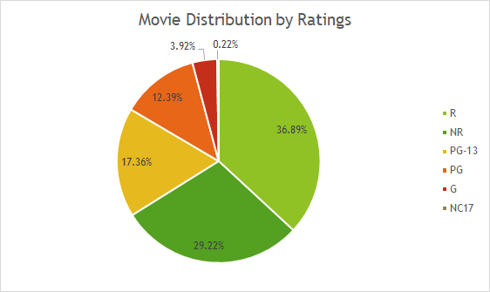
What does the distribution of films look like by rating? My primary genre? (hint: use the first genre listed)
R: 37.89%
NR: 27.25%
PG-13: 17.95%
PG: 12.68%
G: 4.01%
NC-17: 0.22%
1
2
3
4
5
6
Comedy is the most popular genre, followed by drama and action & adventures.

Slide 7
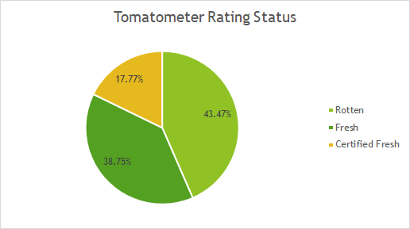
What % of films received a Certified Fresh Tomatometer rating? What about Rotten?
Certified Fresh Tomatometer rating was received by 18.51% of the films.
Rotten Tomatometer rating was received by 43.84% of the films.
This suggests that nearly half of the films were rated as Rotten, while a smaller percentage achieved the Certified Fresh status.
1
2
3
4
5
6

Slide 8
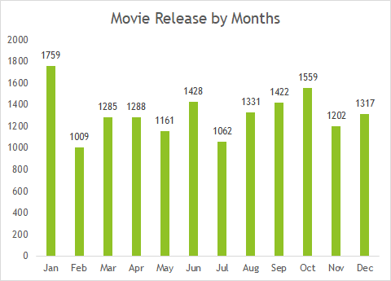
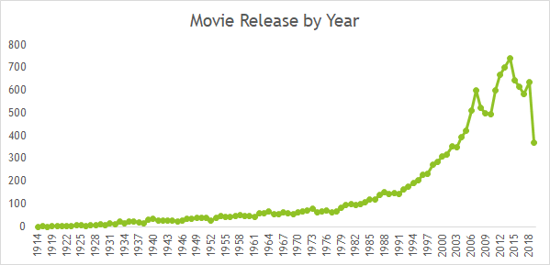
Explore new film releases over time. How has the volume of releases by month trended over time? What year/month were the newest films released?
1
2
3
4
5
6
The volume of film releases has significantly increased over the years, with a noticeable rise from the 1980s onward.

Slide 9
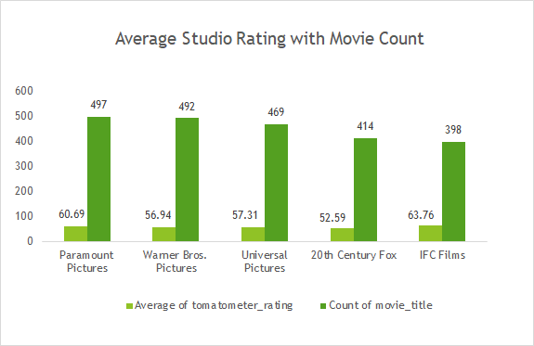
Compare average Tomatometer ratings by Studio. Which studios produce the highest-rated films, on average?
1
2
Paramount Pictures studio produces highest rated films that has an average tomatometer ratings of 60.70.
3
4
5
6

Slide 10
Compare the Tomatometer ratings against audience ratings. Which films showed the largest discrepancies between audiences and critics?
1
2
3
4
5
6
96 Soul - is the movie that has highest discrepancy bewteen the tomatometer rating and audience rating

Slide 11
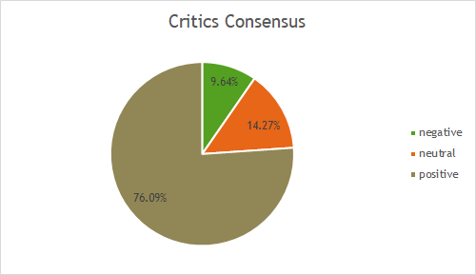
Explore the critic's consensus rating: what language is used most often?
Positive language is used most often, accounting for 76.09% of the ratings.
Neutral language follows at 14.27%.
Negative language is the least common, making up 9.64%.
This indicates that the majority of the critic's consensus ratings are favorable, with positive terms being predominant in the language used.
1
2
3
4
5
6

Slide 12
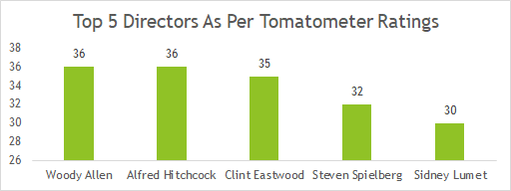
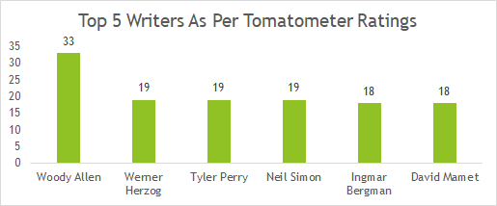
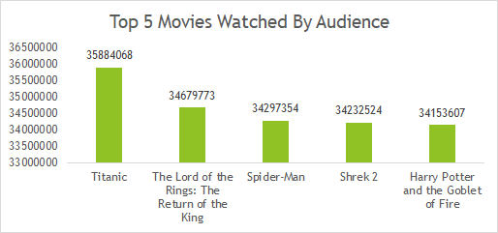


Other Insights

Slide 13

Other Insights
Total Movies - 16.6K
Total Studios - 2.8K
Total Audience - 2.49M
Number Of Genre - 37
Average Movie Runtime - 102.39 Minutes
Average Tomatometer Ratings - 60.46
Average Audience Ratings - 60.47

Slide 14


Conclusion
The Rotten Tomatoes Analysis Report offers a detailed examination of over a century’s worth of film data, providing valuable insights into the factors that contribute to a movie’s success or failure. By analyzing key variables such as genre, director, cast, and release timing, we’ve uncovered significant patterns and trends that have shaped the film industry over time.
The findings from this report underscore the power of data-driven decision-making, enabling industry stakeholders to make more informed choices that align with audience expectations and critical standards.
As the industry continues to evolve, the lessons drawn from this extensive dataset will serve as a guide for creating, marketing, and distributing content that resonates with both critics and audiences.

Slide 15

Thank you
Contact Details
Name :
Kunal Malviya
LinkedIn :
https://www.linkedin.com/in/kunalmalviya06
Email :
kunalmalviya558@gmail.com
Discord :
kunalmalviya
Peerlist :
https://peerlist.io/kunalmalviya06

